Slide 1
Speaking Truth to Power:
The Free-Speech Rights of California University Employees
Prof. Frank LoMonte, J.D.
Brechner Center for Freedom of Information
University of Florida
Notes:
This presentation gives an overview of the law of freedom of speech in the workplace setting of California’s public higher educational institutions. The California State and University of California systems are among the largest employers in the state of California, and it’s helpful for anyone in an employee-employer relationship to understand what the law does and doesn’t protect. There are quite a lot of misconceptions about the law of freedom of speech, and the goal of this presentation is to demystify some of those legal concepts and uncertainties. The First Amendment, and the state laws that supplement it, draw some firm boundary lines that supervisors in the public sector – including public higher education – cannot cross when it comes to regulating employees’ speech. Careful supervisors will respect those boundaries, and avoid creating legal liability for themselves and for their institutions.
Anyone facing a specific question about legally protected free-speech rights should always consult with licensed legal counsel. Viewing an educational presentation is not a substitute for consulting with an attorney to get personalized legal advice.

Slide 2
The First Amendment protects public employees’ speech rights
Lane v. Franks (Supreme Court, 2014)
“[P]ublic employees do not renounce their citizenship when they accept employment, and this Court has cautioned time and again that public employers may not condition employment on the relinquishment of constitutional rights.”
Notes:
The First Amendment is a powerful check on the authority of all government agencies, including educational institutions, that limits their power over what people say or write.
Starting with the landmark 1968 Pickering case, the U.S. Supreme Court has repeatedly reminded all government employers – including educational institutions – that employees don’t abandon their free-speech rights when they accept a government job. That includes sharing knowledge and expertise they’ve gained in their government work. It even includes criticizing the agency that employs them, as long as it’s clear the speaker is speaking as a concerned citizen and not as a representative of the agency or as a disgruntled employee nursing a personal gripe.
The Court’s most recent case about government employee speech, Lane v. Franks, was a higher-education case. The justices unanimously said that a community college whistleblower, Edward Lane, couldn’t be fired in retaliation for helping expose wasteful spending and political corruption within his own agency – even if his supervisors preferred to keep the information under wraps.
Any rule, policy or handbook that requires employees to waive their constitutional rights as a condition of accepting a government job, the Supreme Court has said, will be presumed to be unconstitutional and unenforceable.

Slide 3
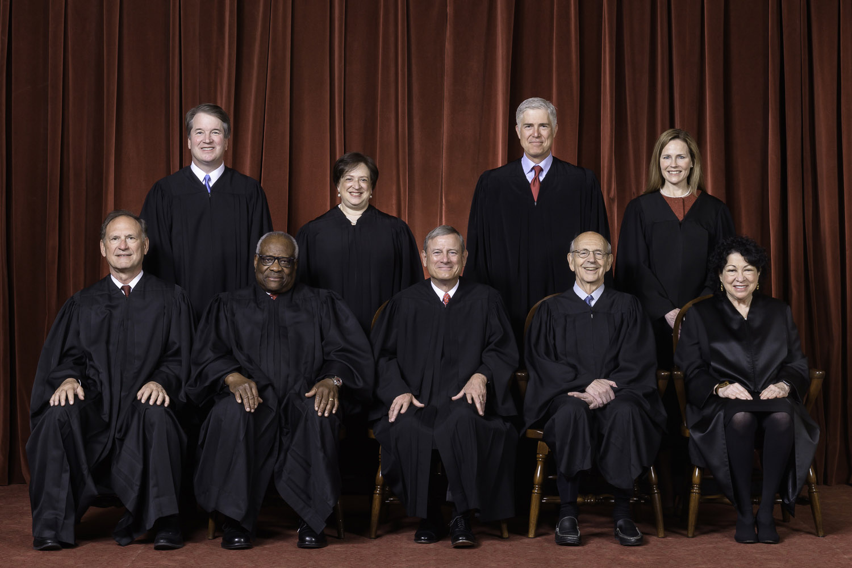
The First Amendment especially forbids “prior restraints” on speech
“Any system of prior restraints of expression comes to this Court bearing a heavy presumption against its constitutional validity.”
Bantam Books, Inc. v. Sullivan (Supreme Court, 1963)
Anytime a government agency acts as a “gatekeeper” deciding who can speak, there must be “neutral and objective criteria” or the regulation is unconstitutional
Notes:
Since the 1930s, the Supreme Court has consistently struck down laws, rules and policies that forbid people from distributing their speech. Federal courts say that, instead of preventing speakers from being heard, the government should wait and see whether the speech causes any harm, and then let the legal system consider whether any compensation is owed – for instance, in the case of libelous speech. A judge can’t stop a publisher from distributing a book, but can award after-the-fact damages to someone who’s libeled in the book. This presumption against “prior restraints” is consistent with the idea that America is a “marketplace” for free speech – even ideas that may be foolish or extreme – and that the best response to unwelcome speech is not to silence it, but to speak back.
The rule against prior restraints is so powerful that the Supreme Court has not even been wiling to restrain a publisher from distributing leaked classified documents stolen from the Pentagon. That’s how heavily the law weighs in favor of speakers and against government censors.
If a government regulation does require advance permission for speaking – for example, a permit to hold a parade – the regulation is unconstitutional unless it clearly sets out the criteria for awarding a permit. A clear set of criteria prevents the decision-maker from making a biased decision based on the viewpoint of the applicant. And federal judges have applied this same principle to regulations on government employee speakers as well.

Slide 4
A policy that forbids
speaking to the media is an unconstitutional prior restraint
Any rule, regulation or policy that requires government employees to get permission before speaking – or puts entire topics off-limits for discussion with the press or public – violates the employees’ First Amendment rights, and can be grounds for a lawsuit
Notes:
It has become commonplace for public agencies at all levels of government – from the Pentagon down to the smallest local school district – to enforce “media policies” that prevent anyone but an authorized spokesperson from answering questions from the news media. While these policies are common, they’re also against the law. Decades of legal interpretations from the federal courts have determined that a rule or policy that inhibits public employees from sharing ideas, opinions and knowledge with the public is unconstitutional.
Think of the Constitution as a floor that the federal government has established, the minimum amount of freedom that individuals must be given. A state or local government agency, including a public college or university, can give people more protection than the First Amendment requires, but not less. Any rule, regulation or policy that fails to provide the minimum constitutionally required level of rights is void, unenforceable, and potentially grounds for a lawsuit.
Government employers can impose discipline if employees speak or write in a way that disrupts the agency’s effectiveness, or calls their fitness for public employment into question. So, an employer can impose discipline if an employee posts racist or anti-Semitic rants on a blog, causing the public to distrust the employee’s ability to do their job competently. But what an employer cannot do is forbid employees from saying anything work-related to the press or public without approval.

Slide 5
Example:
Moonin v. Tice (9th Circuit 2017)
A state highway patrol policy that forbade talking about the agency’s controversial K-9 program without approval was unconstitutional: “Avoiding accountability by reason of persuasive speech to other governmental officials and the public is not an interest that can justify curtailing officers' speech as citizens on matters of public concern.”
Notes:
In 1995, the Supreme Court decided its first real “prior restraint” case in the government workplace, the National Treasury Employees case. The law that the employees were challenging wasn’t even a total restraint on speaking. It just said employees of the federal government couldn’t accept fees for writing articles or giving speeches, which was supposed to prevent bribery and influence-buying. But even that law – which discouraged speech, but didn’t totally prevent it – was still unconstitutional, the Supreme Court decided.
In the years that followed, court after court relied on the Treasury Employees decision to declare restrictions on government employees’ speech unconstitutional. This includes the federal Ninth Circuit Court of Appeals, which is the appeals court that delivers binding interpretations of the Constitution for California and 14 other western states and territories. In a 2017 case, Moonin v. Tice, the Ninth Circuit court unanimously sided with a Nevada highway patrol officer who was disciplined for violating a rule that required getting clearance before saying anything about the agency’s use of police dogs, which had become a matter of public controversy.
The Moonin decision is consistent with the way federal courts across the country have interpreted the First Amendment. Appeals courts in New York, Illinois and Louisiana have all agreed that ordering employees not to talk to the press, or restricting the subjects they can talk about, violates their constitutional rights. That opens up the employer – and possibly even the individual decision-maker – to being sued in federal court.

Slide 6
Employee speech is especially well-protected in higher education
The Supreme Court has called college campuses “peculiarly the marketplace of ideas,” where the First Amendment applies even to extreme, controversial speech
College faculty members are doubly well-protected – the Ninth Circuit says their on-the-job speech gets even stronger protection than other government employees’
Notes:
Freedom of speech is heavily protected on the campuses of public colleges and universities. Federal courts have repeatedly said that it’s unconstitutional for administrators to punish people because of the ideas they express, or to deny people the opportunity to use campus property to protest or demonstrate. Even indirect acts of censorship can violate the First Amendment, such as refusing to let student organizations use meeting space, or disqualifying them from receiving funding, just because they express strong political or religious viewpoints.
This strong constitutional protection extends of employees of colleges as well, going all the way back to the “McCarthy witch hunt” era of the 1950s, when the Supreme Court said it’s illegal to force college employees to sign patriotic “loyalty oaths” as a precondition of keeping their jobs. And the protection is even stronger when the speaker is a faculty member protected by the principle of academic freedom.
Employers normally have quite a lot of latitude to punish or even fire employees who don’t follow instructions when they’re speaking in the course of their regular employment. But in 2014, the Ninth Circuit appeals court decided that faculty members aren’t subject to that same level of employer control. The judges sided with a university professor, Dave Demers, who was retaliated against for publicly circulating a restructuring plan critical of the way his college was managed. The judges said that college instructors are entitled to greater freedom of speech than ordinary government employees, because universities are meant to foster wide-open discussion of ideas, even ideas that challenge authority.

Slide 7
California law has additional speech protections for employees
Cal. Govt. Code § 8547 (“Whistleblower Protection Act”)
Cal. Govt. Code § 12964.5 (“Silenced No More Act”)
Calif. Const. Art. 1, § 2(a) (Declaration of Rights)
Illegal for a supervisor to retaliate for disclosing improper government activity
Employees can’t be forced to sign broad “nondisparagement” agreements
“Every person may freely speak, write and publish his or her sentiments on all subjects, being responsible for the abuse of this right. A law may not restrain or abridge liberty of speech or press”
Notes:
California state law is considered relatively pro-labor, and it includes some extra protections for workers’ rights that supplement the rights guaranteed by the U.S. Constitution. It’s important to understand those rights, but also to understand that they’re relatively narrow.
The California Government Code protects the rights of UC and CSU system employees to report waste, mismanagement, or other improper government activity, either to the state auditor, to law enforcement, or up the chain of command within the agency. So state whistleblower protections cover internal reports of wrongdoing, but probably will not extend to external disclosures to the public or news media. For that, employees must rely on their federally protected First Amendment rights.
Just recently, the governor and legislature added a new statutorily protected right: The right not to sign a broad nondisclosure or nondisparagement agreement. Any agreement that would restrain an employee from disclosing a violation of the law is an illegally broad agreement ,and it’s unenforceable. This new right is intended to empower victims of serious sexual misconduct in the workplace to warn other people about the danger without retaliation.
It’s also possible that the California state constitution would offer employees an added measure of rights beyond what federal law protects. California courts say that Article 1, Section 9 – the free expression clause of the California Constitution – is even broader than the federal First Amendment. But its breadth has never been tested in the context of a rule or directive that silences public employees.

Slide 8
Examples of regulations found to be illegal
Firefighters may not make “statements for publication concerning the plans, policies, or affairs of the administration of the fire department”
Highway patrol officers may not make “official comments relative to department policy” without a supervisor’s approval
Sheriff’s deputies may not make “unauthorized public statements” or speak to the press on any topic “that is or could be of a controversial nature”
Notes:
More than two dozen times, public employees across the country have taken their employers to court over rules or policies that forbid speaking to the news media. The employees have prevailed in every one of these challenges, spanning more than 50 years. It doesn’t matter whether the restriction is phrased as a handbook or a regulation or a contract provision – anything that would place a public employee in fear of disciplinary action for speaking to the press violates the First Amendment.
Most court challenges have been brought by union lawyers representing law enforcement officers or firefighters. Even in those quasi-military settings where the federal courts give great deference to the employer’s ability to maintain discipline, a blanket prohibition against talking to the news media never survives First Amendment scrutiny. If these types of rules are illegal within a police department or fire department, they are even more clearly illegal within a college or university campus, where First Amendment rights are at their highest and the employer’s discretion to restrict speech is at its lowest.

Slide 9
Red flags of a legally problematic employee speech policy
Blanket gag on speaking without approval
Criticism of the government is restricted or banned
Supervisor has total discretion to grant or deny permission
Goes beyond protecting information that legally must be kept confidential
Notes:
It’s legal for a government employer to enforce what’s known as a “narrowly tailored” policy that restricts only the speech necessary for the agency to do its job effectively. For instance, if the agency is charged with safeguarding confidential medical or educational records, it’s legal to require employees to keep those confidences and not compromise legally protected privacy rights. But many government rulebooks, including those in higher education, aren’t narrowly tailored. Any policy that either forbids speaking to the press, or requires approval before speaking, is unconstitutionally broad.
Any government policy that prevents speech based on the speaker’s viewpoint is strongly presumed to be unconstitutional. It’s a red flag if a speech regulation says that employees can’t make statements about government agencies or government policies that are “critical” or “negative.” The Constitution doesn’t allow government agencies, including public educational institutions, to use their authority to silence critics.

Slide 10
What a legally adequate policy should look like
Makes clear that employees are free to speak in their “citizen” roles without permission
Restricts only speakers who are assigned to speak as part of their official job duties
Restricts only the disclosure of information that is legally protected against disclosure
Assistance of a P.R. professional is an optional service, not a mandatory clearance
Notes:
An employer can legitimately restrict employees from sharing information with the public in a few limited circumstances. First, when the employee is assigned to speak as part of official job duties, such as writing a memo or distributing a press release. Second, when the employee is speaking as an official spokesperson for the organization, such as a police officer who’s assigned at a crime scene to brief the news media. And third, when information is legally protected against disclosure, such as patient records in a state hospital.
It’s always a good idea for employees speaking to the media to explain that they’re speaking in a personal capacity and not on behalf of the employer, just to make these roles clear. But government policies should also be clear. They should assure employees that, when they’re not speaking in an official role, they have the right to give interviews without needing anyone’s permission.
An optimal policy will recognize the value of consulting with a public relations professional for anyone who is inexperienced in dealing with the media or nervous about a sensitive subject. But consultation can’t be mandatory, and failure to consult with the agency’s P.R. office before speaking can’t be grounds for disciplinary action.

Slide 11
For more information…
UC Center for Free Speech & Civic Engagement
University of California-Irvine
freespeechcenter@uci.edu
https://freespeechcenter.universityofcalifornia.edu/
Brechner Center for Freedom of Information
University of Florida
brechnerreport@jou.ufl.edu
www.brechner.org
Notes:
The University of California Center for Free Speech and Civic Engagement has a wealth of resources on its website to help educate the public about the law of freedom of expression. The UC Center provides periodic online lectures and workshops promoting greater awareness and understanding about the importance of free speech to a well-functioning, participatory democracy. You can sign up for alerts and updates at freespeechcenter.universityofcalifornia.edu.

